Slide 1
Storage
raw pegs
■ ×4 ● ×4
M1
CNC trimming
■ ×4
UR5e-1
machine tending
■ ×4
KUKA KMR
mobile robot
■ ×4 ● ×4
Conveyor
belt transport
■ ×4 ● ×4
Buffer
4 zones
■ ×4 ● ×4
UR5e-3
assembly
■ ×4 ● ×4 ▣ ×1
Exit
finished product
▣ ×1
M2
CNC trimming
● ×4
UR5e-2
machine tending
● ×4
Assembly Board
assembly_board-v1
■ ×4 ● ×4 ✹ ×3
by UR5e-3
Storage / buffer
Transport
Processing
Robot arm
Printer
3D printing
✹ ×3
UR5e-4
gear assembly
✹ ×3
Product
Part flow
■ KET square peg
● RGOCG round peg
✹ Printed gear
▣ Finished board

Slide 2
Storage
raw pegs
■ ×4 ● ×4
3
2
M1
CNC trimming
■ ×4
UR5e-1
machine tending
■ ×4
Failure scenarios
1
Conveyor breakdown
2
ur5e-1 breakdown
3
Machining breakdown during part processing
4
Part slippage
KUKA KMR
mobile robot
■ ×4 ● ×4
1
Conveyor
belt transport
■ ×4 ● ×4
Buffer
4 zones
■ ×4 ● ×4
UR5e-3
assembly
■ ×4 ● ×4 ▣ ×1
Exit
finished product
▣ ×1
M2
CNC trimming
● ×4
UR5e-2
machine tending
● ×4
Assembly Board
assembly_board-v1
■ ×4 ● ×4 ✹ ×3
by UR5e-3
4
Storage / buffer
Transport
Processing
Robot arm
Printer
3D printing
✹ ×3
UR5e-4
gear assembly
✹ ×3
Product
Part flow
■ KET square peg
● RGOCG round peg
✹ Printed gear
▣ Finished board

Slide 3
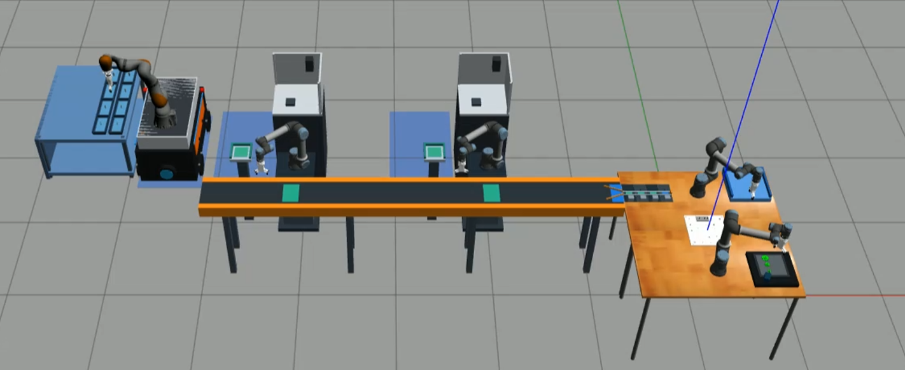
KUKA KMR
M1
M2
UR5e-2
UR5e-3
UR5e-1
Buffer
Exit
Storage
Conveyor
Assembly
Board
Printer
UR5e-4

